Slide 1

A Federated Learning-based
Weather Monitoring System.
Presented by
Authors: Rik Halder
Department of Computer Science & Engineering
National Institute of Technology, Rourkela, Odisha - 769008
Contact: 223cs3148@nitrkl.ac.in
Under the Supervision of
Prof. Suchismita Chinara
Department of Computer Science & Engineering
National Institute of Technology, Rourkela, Odisha - 769008
Contact: suchismita@nitrkl.ac.in
1

Slide 2
Table of Contents
Introduction
Literature Review
Objectives of the Study
Dataset Overview
Client Division
Methodology
Results and discussion
Conclusion
Future Work
References
Acknowledgements
Contact Details

Slide 3
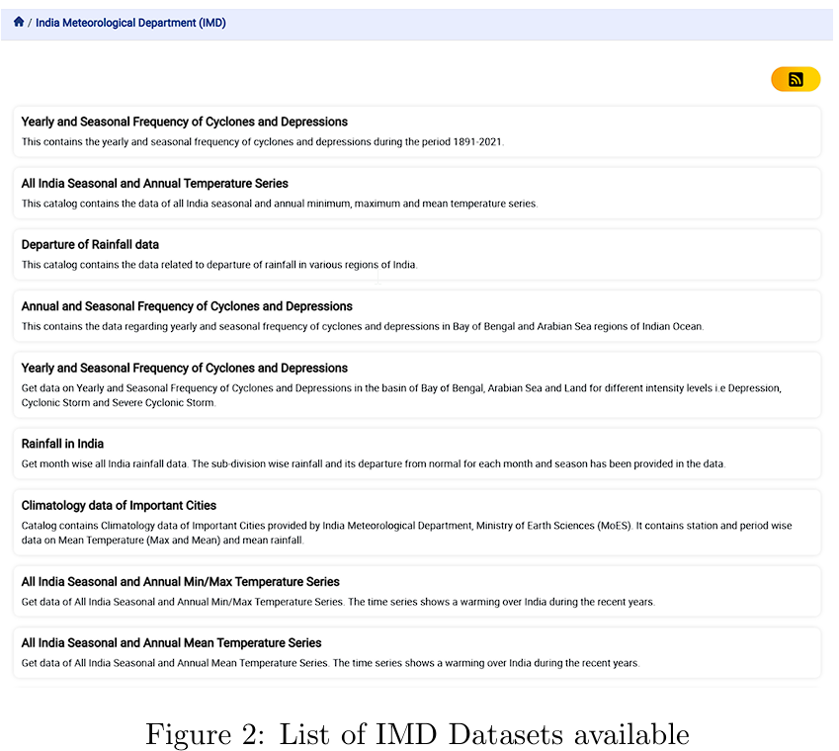
The Traditional Weather Monitoring
Weather monitoring plays a critical role in agriculture, disaster management, and daily life.
The Problem with Traditional Weather Monitoring
Limited Parameters
Focus on temperature
Insufficient data on humidity , precipitation , wind etc
Sparse Regional Classification
Data not stratified by zones
Lacks localized insights
Lack of granularity
Annual data available
No monthly or hourly classification
Figure 1 : Problems of traditional weather dataset
Figure 2 : List of IMD Datasets available

Slide 4
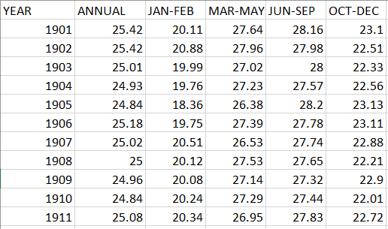
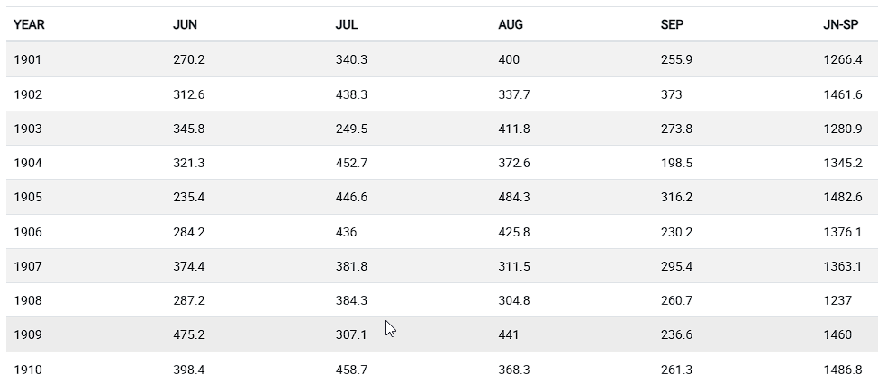
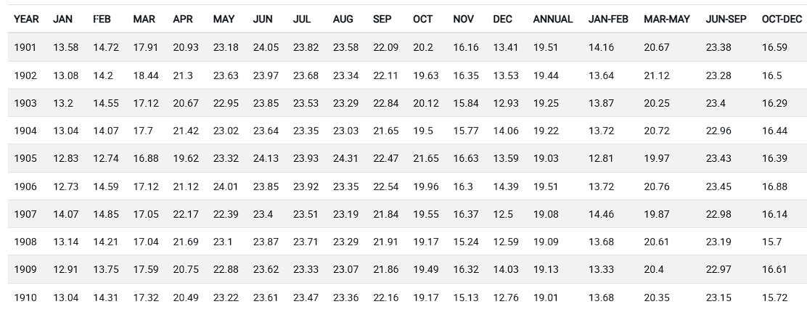
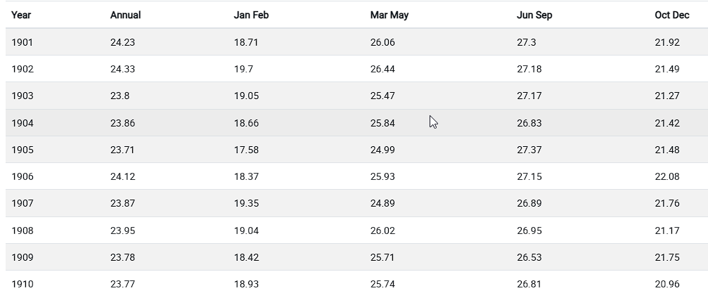
Existing IMD Datasets
Figure 3: Annual mean temp series for 1901-2021
Figure 4: Rainfall in NE India and its departure from
normal.
Figure 5: Monthly, Seasonal and Annual Minimum Temperature
Series from 1901 to 2019
Figure 6: Seasonal and Annual Mean Temp Series
from 1901 to 2017

Slide 5
Federated Learning: A Decentralized Solution
Models Trained Locally
Ensures Privacy
Why Federated Learning for Weather Monitoring?
Decentralized
Enhances privacy by keeping sensitive weather data local.
Enables region-specific training for localized and accurate forecasts.
Handles heterogeneous data from diverse weather stations effectively.
Scales easily to accommodate new weather stations
Introduction
to Federated Learning:
Scalability

Slide 6
Literature Review
Category | Author(s) | Year | Key Contributions
FL Reviews | Wen et al.[5], Banabilah[6] | 2023, 2022 | Evolution of FL, IoT applications
Frameworks | He et al.[12] | 2021, 2020 | Flower for scalability, FedML for benchmarks
Strategies | Konečný et al.[11] , Rodio et al.[13] | 2023,2018 | FedAvg efficiency, CA-Fed addressing heterogeneity
Weather Data | Fu et al.[14], | 2024 | CNN-LSTM for alerts, MetePFL for spatiotemporal predictions

Slide 7
Objectives of the Study
High resolution weather dataset
Granular data with multiple weather parameters
Localized forecasts
Training model with region specific data
Federated learning based weather monitoring system
To enable decentralized , privacy-preserving weather forecasting
Scalability
Ensuring seamless integration of new weather stations

Slide 8
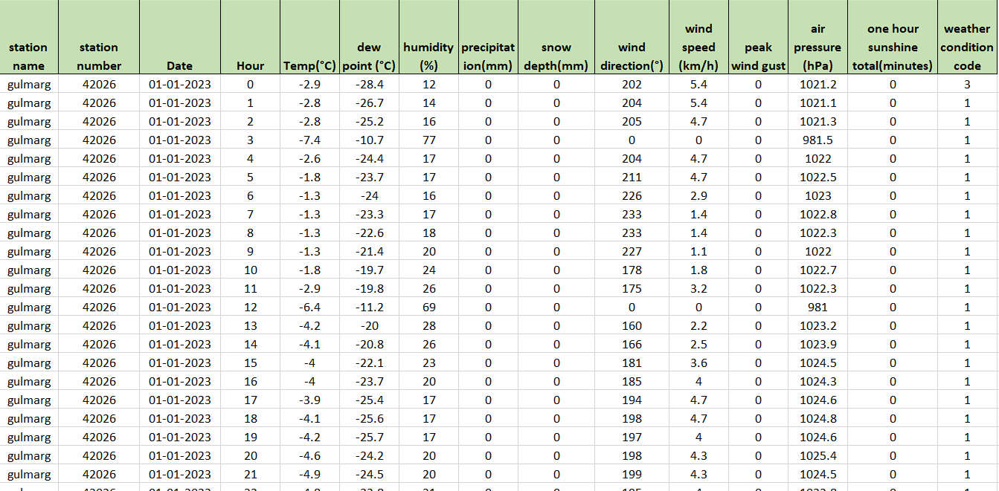
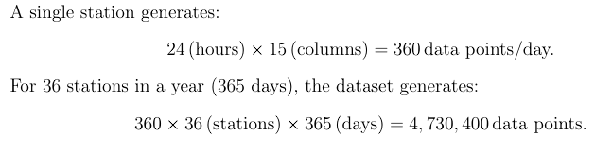
Dataset Overview
Figure 7: My Weather Dataset
Data Type - Hourly data
Weather Stations – 36
Weather parameters – 15
Timeline – year 2023
Figure 8 : My Weather Dataset Structure

Slide 9
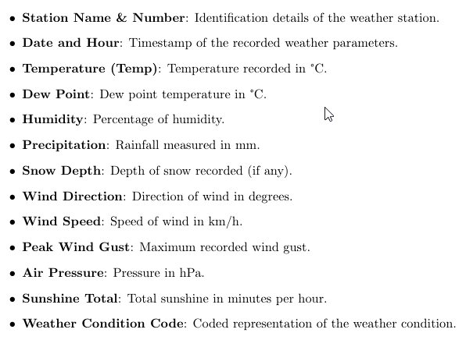
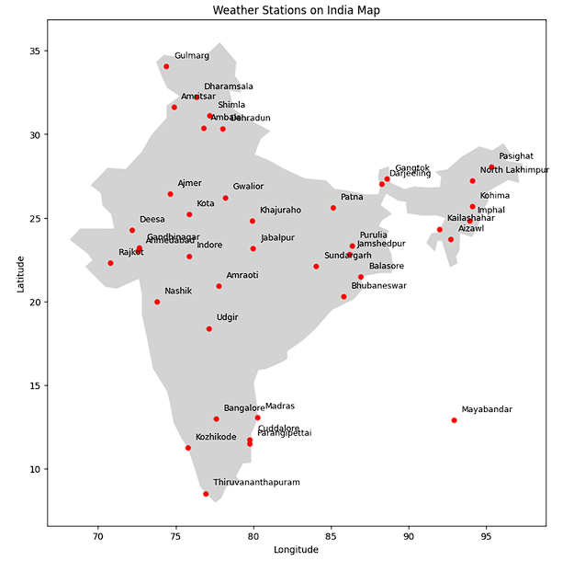
Weather Parameters
Weather Stations
Figure 9 : Weather Dataset Parameters
Figure 10 : Weather Stations

Slide 10
Client Distribution
Zone wise distribution
East Zone
Season Wise Distribution
Winter
Spring
West Zone
South Zone
Central Zone
Summer
Autumn
North Zone

Slide 11
Methodology
Data Collection
Collected from Meteostat
Data Preprocessing
Cleaning raw data
Handling Missing values
Models
MLP
Selected 36 weather stations.
LSTM
Transformers
Federated
Learning
Algorithms
Predict trained models with unknown data
FedAvg
FedProx
Prediction

Slide 12
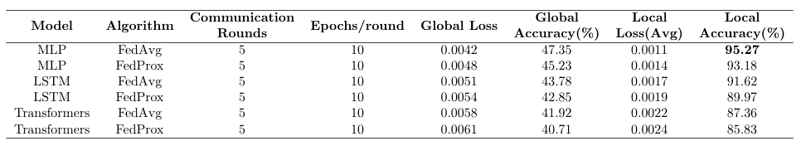
Results and Discussion
Performance Evaluation of Federated Learning Models
Parameter | Models/strategies used
Models Evaluated | MLP, LSTM, Transformers.
FL Strategies | FedAvg, FedProx.
Metrics | Global accuracy, local accuracy, and loss.
Figure 11 : Performance of Models and Algorithms
MLP with FedAvg emerged as the best-performing model with
highest global Accuracy (47.35%) and
local accuracy(95.27%)

Slide 13
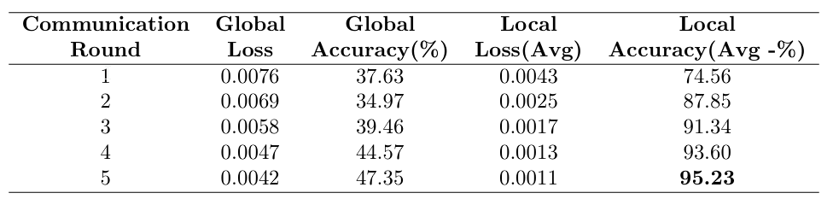
Focus on Best Model: MLP with FedAvg
Figure 12 : Performance of MLP with FedAvg
Key Insights
The Global Loss steadily decreased across communication rounds
The global accuracy has a notable growth
The average local loss showed a notable improvement, dropping to 0.0011 by the fifth round.
The average local accuracy increased from 74.51% to 95.27%, indicating effective personalization and adaptation.

Slide 14
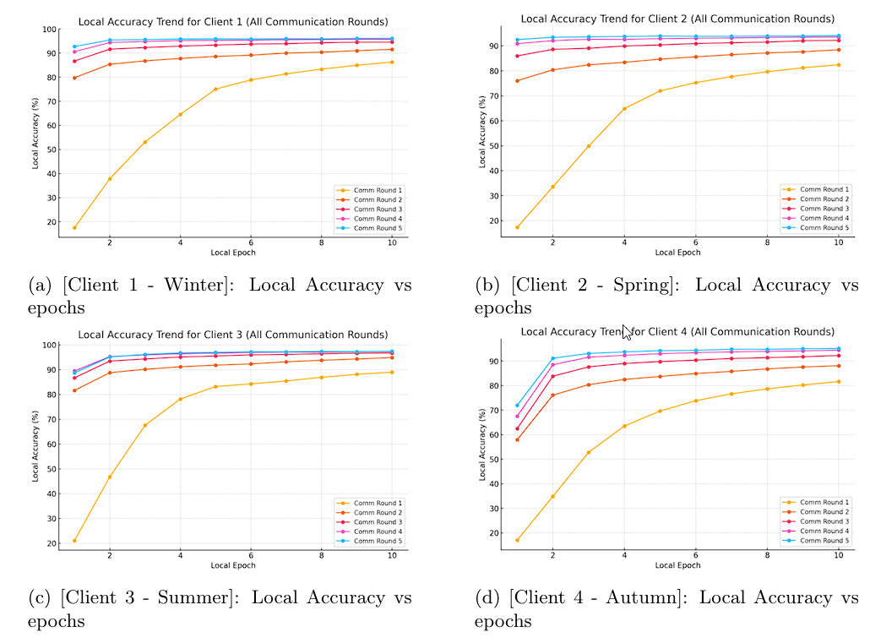
Client Local Accuracy vs Epochs
Figure 13 : Client Local Accuracy vs Epochs

Slide 15
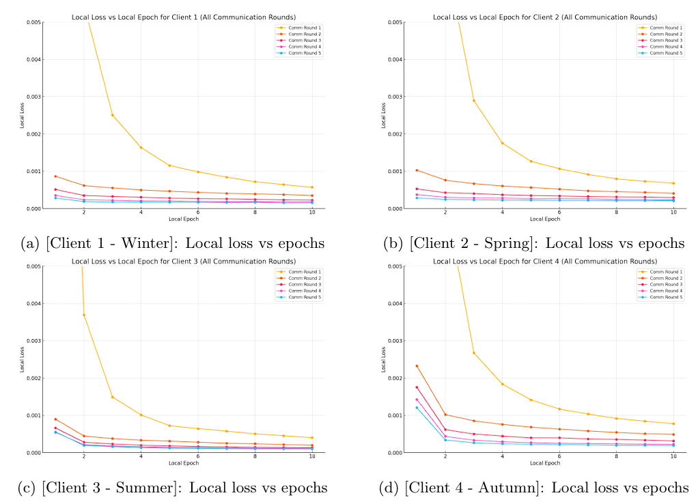
Client Local Loss vs Epochs
Figure 14 : Client Local Loss vs Epochs

Slide 16
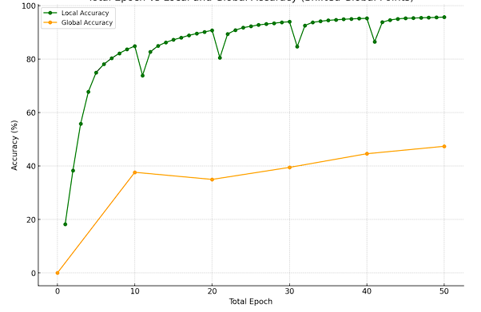
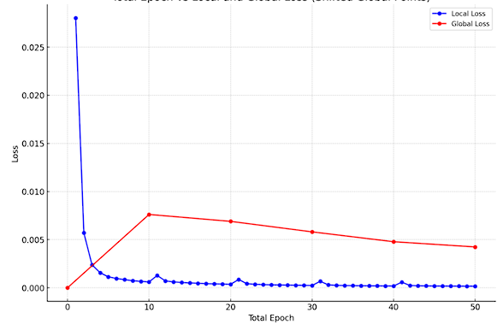
Local and global accuracy and loss vs epochs
Figure 15 : Local and Global Accuracy vs Epochs
Figure 16 : Local and Global Loss vs Epochs

Slide 17
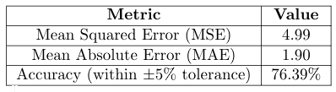
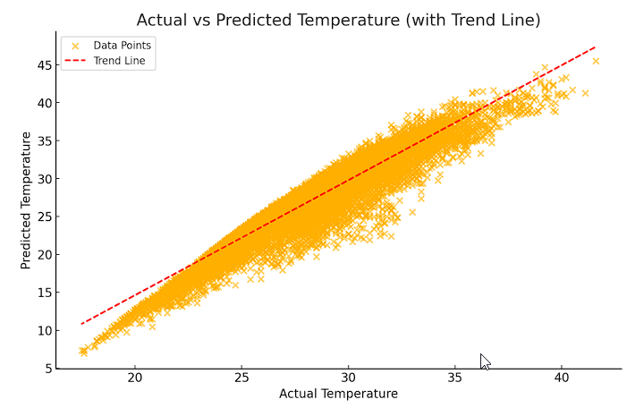
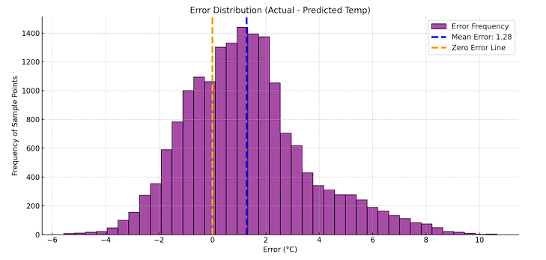
Prediction Results
Figure 17 : Scatter Plot Of Actual Vs
Predicted Temperatures
Figure 18 : Error Distribution (Actual- Predicted Temp)

Slide 18
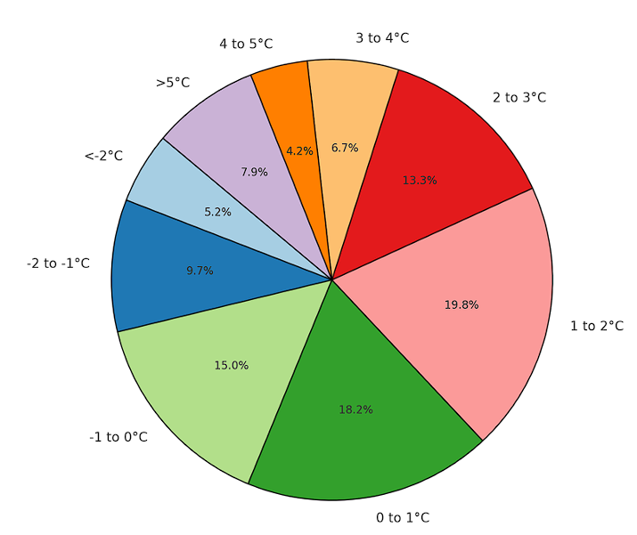
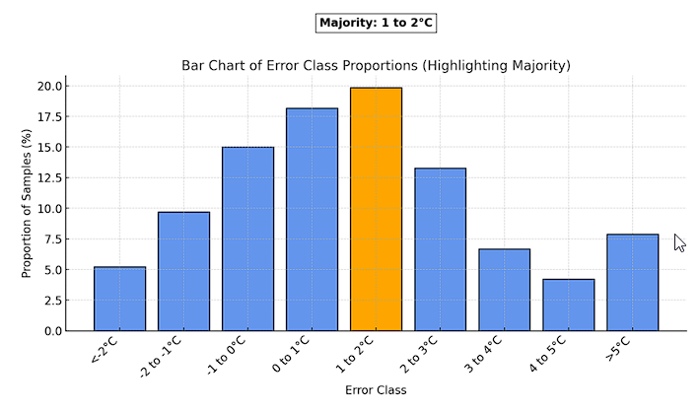
Prediction Results
Figure 19 : Error Class Peoportions
Figure 20 : Bar Chart Of Error Class Proportions

Slide 19
Results in a Nutshell
MLP + FedAvg achieved the best tradeoff between accuracy and efficiency.
FL training maintained data privacy and handled non-IID distribution of data.
Demonstrated potential real-world forecasting.

Slide 20
Conclusion
Federated Learning has demonstrated its transformative potential in decentralized weather prediction, overcoming limitations of traditional meteorological systems. By achieving enhanced accuracy, preserving data privacy, and enabling scalable solutions, this research bridges the gap between conventional meteorology and innovative collaborative machine learning techniques. This study lays a robust foundation for future advancements, integrating modern FL approaches to revolutionize weather forecasting methodologies.

Slide 21
Future Work
Dataset Enhancement: Extend the dataset with inclusion of more weather stations spread over various geographies for further accuracy and strength in the model.
Integration of Federated Simulators: Validate and test the framework with high-performance federated learning simulators to compare performance with varied setups.
Application Development: Design an end-user application that monitors and predict sreal-time weather and implements the developed models to achieve real-world applicability.
Long-term Predictions: Extend the current framework to predict long-term weather pat-terns and analyze its feasibility for seasonal and annual predictions.

Slide 22
References
[1] V. S. Negi and S. Chinara, “Study of mobilenets model in federated learning,” in 2023IEEE Intl Conf on Dependable, Autonomic and Secure Computing, Intl Conf on Pervasive Intelligence and Computing, Intl Conf on Cloud and Big Data Computing, Intl Conf on Cyber Science and Technology Congress (DASC/PiCom/CBDCom/CyberSciTech). IEEE,2023, pp. 1040–1044.
[2] B. McMahan, E. Moore, D. Ramage, S. Hampson, and B. A. y Arcas, “Communication-efficient learning of deep networks from decentralized data,” in Artificial intelligence and statistics. PMLR, 2017, pp. 1273–1282.
[3] T. Li, A. K. Sahu, M. Zaheer, M. Sanjabi, A. Talwalkar, and V. Smith, “Federated optimization in heterogeneous networks,” Proceedings of Machine learning and systems, vol. 2, pp. 429–450, 2020.
[4] M. Asad, A. Moustafa, and T. Ito, “Fedopt: Towards communication efficiency and privacy preservation in federated learning,” Applied Sciences, vol. 10, no. 8, p. 2864, 2020.
[5] J. Wen, Z. Zhang, Y. Lan, Z. Cui, J. Cai, and W. Zhang, “A survey on federated learning: challenges and applications,” International Journal of Machine Learning and Cybernetics, vol. 14, no. 2, pp. 513–535, 2023.

Slide 23
References
[6] S. Banabilah, M. Aloqaily, E. Alsayed, N. Malik, and Y. Jararweh, “Federated learn ing review: Fundamentals, enabling technologies, and future applications,” Informa tion processing & management, vol. 59, no. 6, p. 103061, 2022.
[7] H. Zhu, H. Zhang, and Y. Jin, “From federated learning to federated neural archi tecture search: a survey,” Complex & Intelligent Systems, vol. 7, no. 2, pp. 639–657, 2021.
[8] D. C. Nguyen, M. Ding, P. N. Pathirana, A. Seneviratne, J. Li, and H. V. Poor, “Federated learning for internet of things: A comprehensive survey,” IEEE Commu nications Surveys & Tutorials, vol. 23, no. 3, pp. 1622–1658, 2021.
[9] S. K. Lo, Q. Lu, C. Wang, H.-Y. Paik, and L. Zhu, “A systematic literature review on federated machine learning: From a software engineering perspective,” ACM Computing Surveys (CSUR), vol. 54, no. 5, pp. 1–39, 2021.
[10] L. Li, Y. Fan, M. Tse, and K.-Y. Lin, “A review of applications in federated learning,” Computers & Industrial Engineering, vol. 149, p. 106854, 2020.

Slide 24
[11] J. Koneˇcn` y, “Federated learning: Strategies for improving communication
efficiency,” arXiv preprint arXiv:1610.05492, 2016.
[12] C. He, S. Li, J. So, X. Zeng, M. Zhang, H. Wang, X. Wang, P. Vepakomma, A. Singh, H. Qiu et al., “Fedml: A research library and benchmark for federated machine learning,” arXiv preprint arXiv:2007.13518, 2020.
[13] A. Rodio, F. Faticanti, O. Marfoq, G. Neglia, and E. Leonardi, “Federated learning under heterogeneous and correlated client availability,” in IEEE INFOCOM 2023 IEEE Conference on Computer Communications. IEEE, 2023, pp. 1–10.
[14] X. Fu, C. Zhang, F. Chang, L. Han, X. Zhao, Z. Wang, and Q. Ma, “Simulation and forecasting of fishery weather based on statistical machine learning,” Information Processing in Agriculture, vol. 11, no. 1, pp. 127–142, 2024.

Slide 25
Acknowledgements
I would like to express my sincere gratitude to:
Prof. Suchismita Chinara for her invaluable guidance throughout the project.
The Department of Computer Science and Engineering at NIT Rourkela for providing the resources and platform to conduct this research.
My PhD advisor Vipul Singh Negi, my family, peers and other fellow researchers for their continuous encouragement and support.

Slide 26

Contact Details
NAME – RIK HALDER
INSTITUTE – NIT ROURKELA
COURSE – M.TECH
DEPARTMENT – COMPUTER SCIENCE AND
ENGINEERING
SPECIALISATION – SOFTWARE ENGINEERING
ROLL NO – 223CS3148
MOBILE NO – 7001278854
EMAIL ID – 223cs3148@nitrkl.ac.in

Slide 27
Thank You

